Slide 1
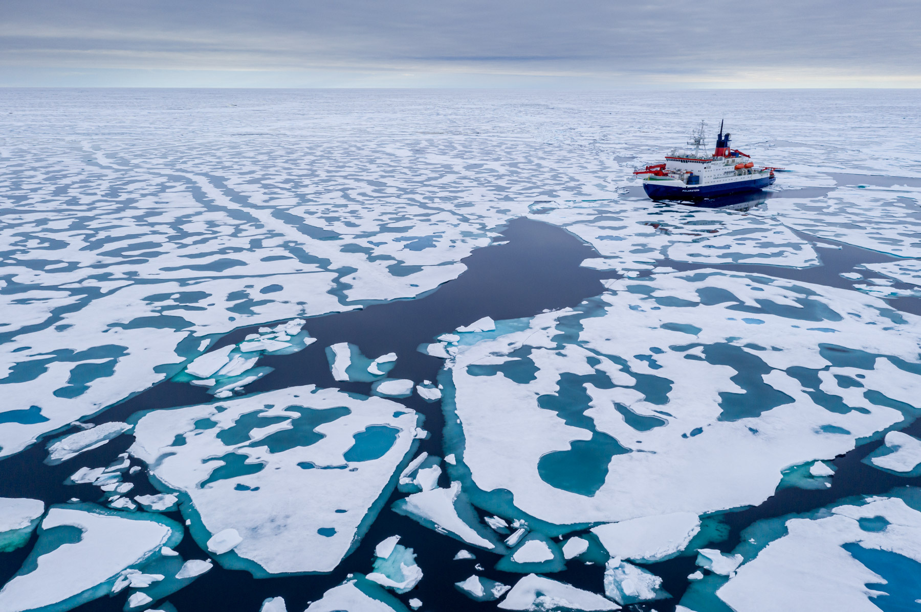
Arctic Melt Ponds
Exploring fractal dimensions of Arctic Melt Ponds
Presented by: Group 7

Slide 4
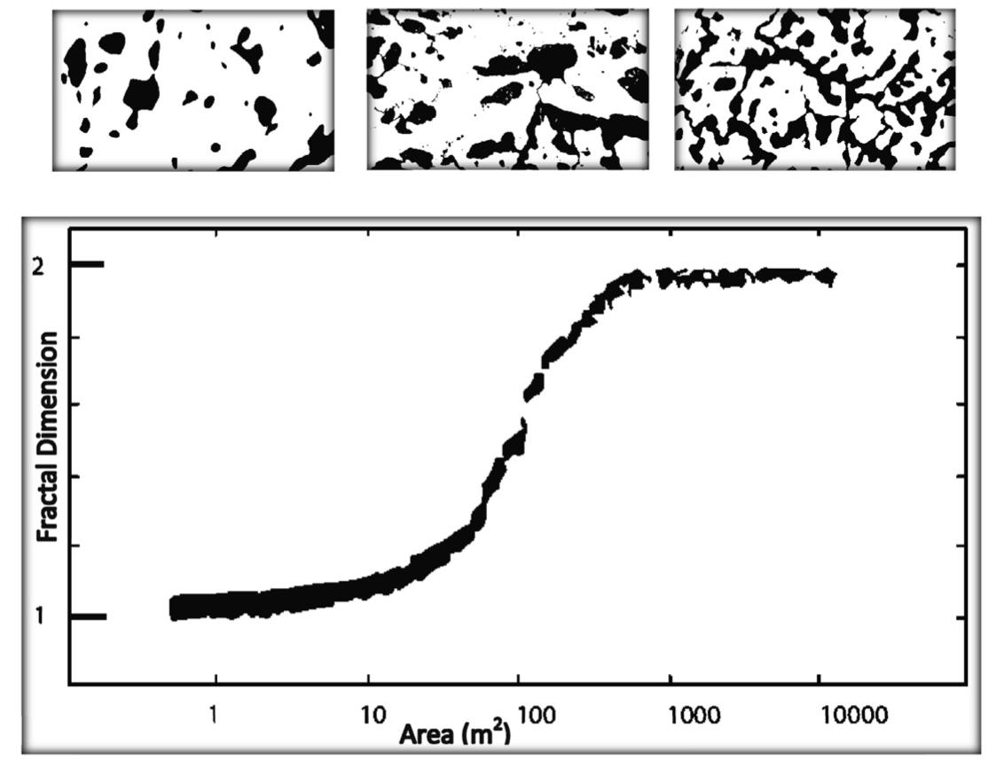

Slide 5
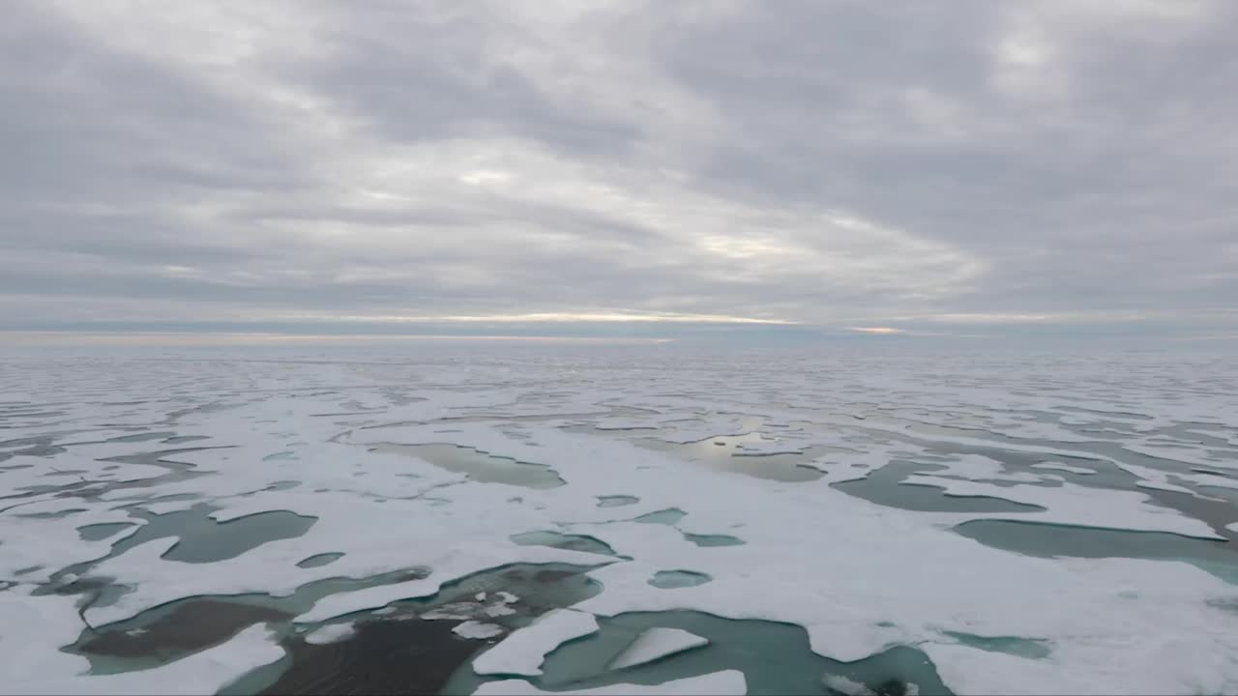
Understanding Climate Feedback Mechanisms
Enhancing Predictions of Arctic Sea Ice Decline
Advancing Climate Modeling Accuracy
By developing a physics-informed cellular automata (CA) model of melt ponds, we aim to improve the precision of climate models.
Melt ponds play a significant role in accelerating the melting process by reducing the ice's albedo.
The Arctic region is experiencing rapid ice loss, and understanding the dynamics of melt ponds is crucial for predicting future changes.

Slide 6
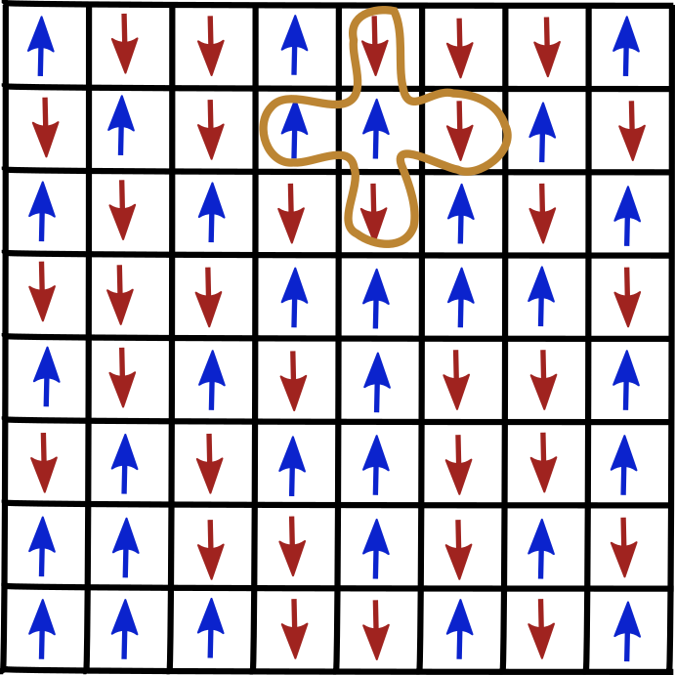
Ma, Y.-P., Sudakov, I., Strong, C., & Golden, K. M. (2019). Ising model for Melt Ponds on Arctic Sea Ice. New Journal of Physics,
21(6), 063029. https://doi.org/10.1088/1367-2630/ab26db
Baseline Ising Model
Pond and Ice as metastable states determined by binary spin
Random initialisation of cell spin
Magnetisation force field represents Topography
random normal initialisation
If most neighbours in one state, adjust to that state
Forcefield only relevant, if 2 ice and 2 water neighbours

Slide 7
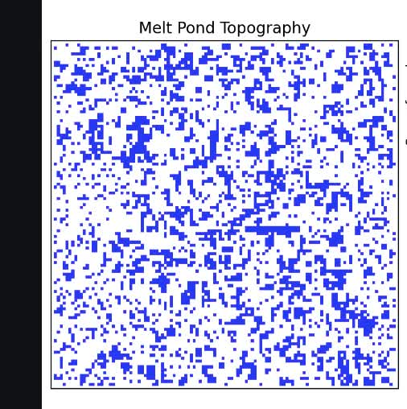
Baseline Ising Model
No physical processes needed to observe fractal patterns
No time evolution
No melting
2D: No sense of ice block height or pond depth
No seepage of water through ice
Pond presence does not influence melting process

Slide 8


RESEARCH QUESTION
HYPOTHESES
Can a physics-informed cellular automata (CA) model of melt ponds replicate and inform about the physical processes needed for the fractal behaviour observed in the Ising model and in real data?
1
The physics-informed CA model will demonstrate the same transition in fractal dimension as observed in the Ising model.
Removing model specifics will be able to break the emergence.
2

Slide 9
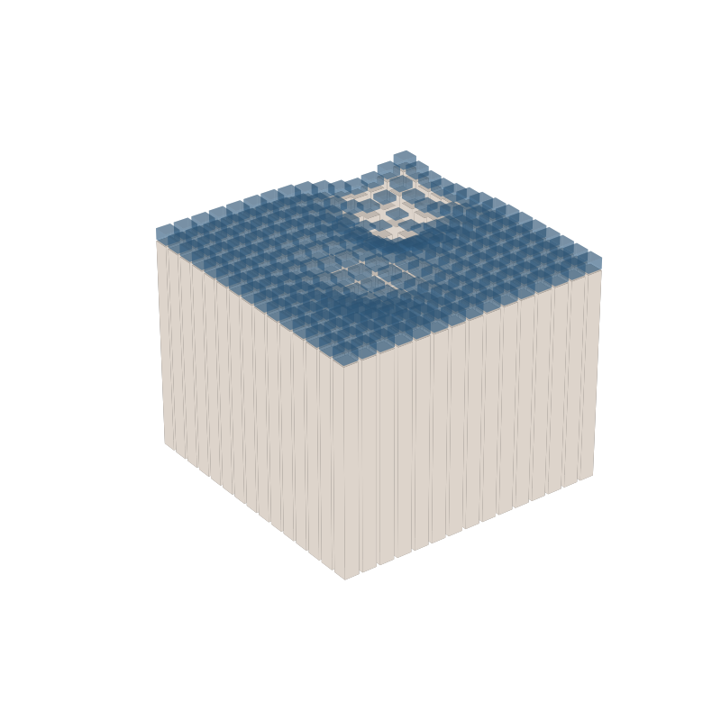
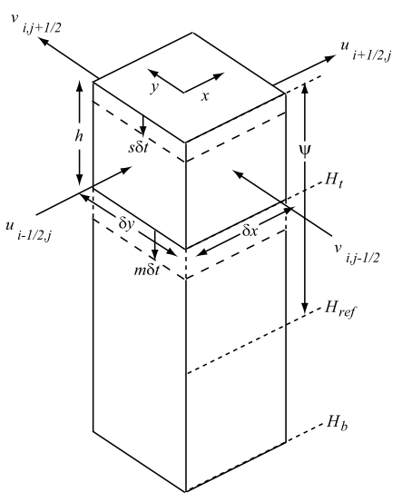
Lüthje, M., D. L. Feltham, P. D. Taylor, and M. G. Worster (2006), Modeling the summertime evolution of sea-ice melt ponds, J. Geophys. Res., 111, C02001, doi:10.1029/2004JC002818.
CA Model Setup

Slide 10
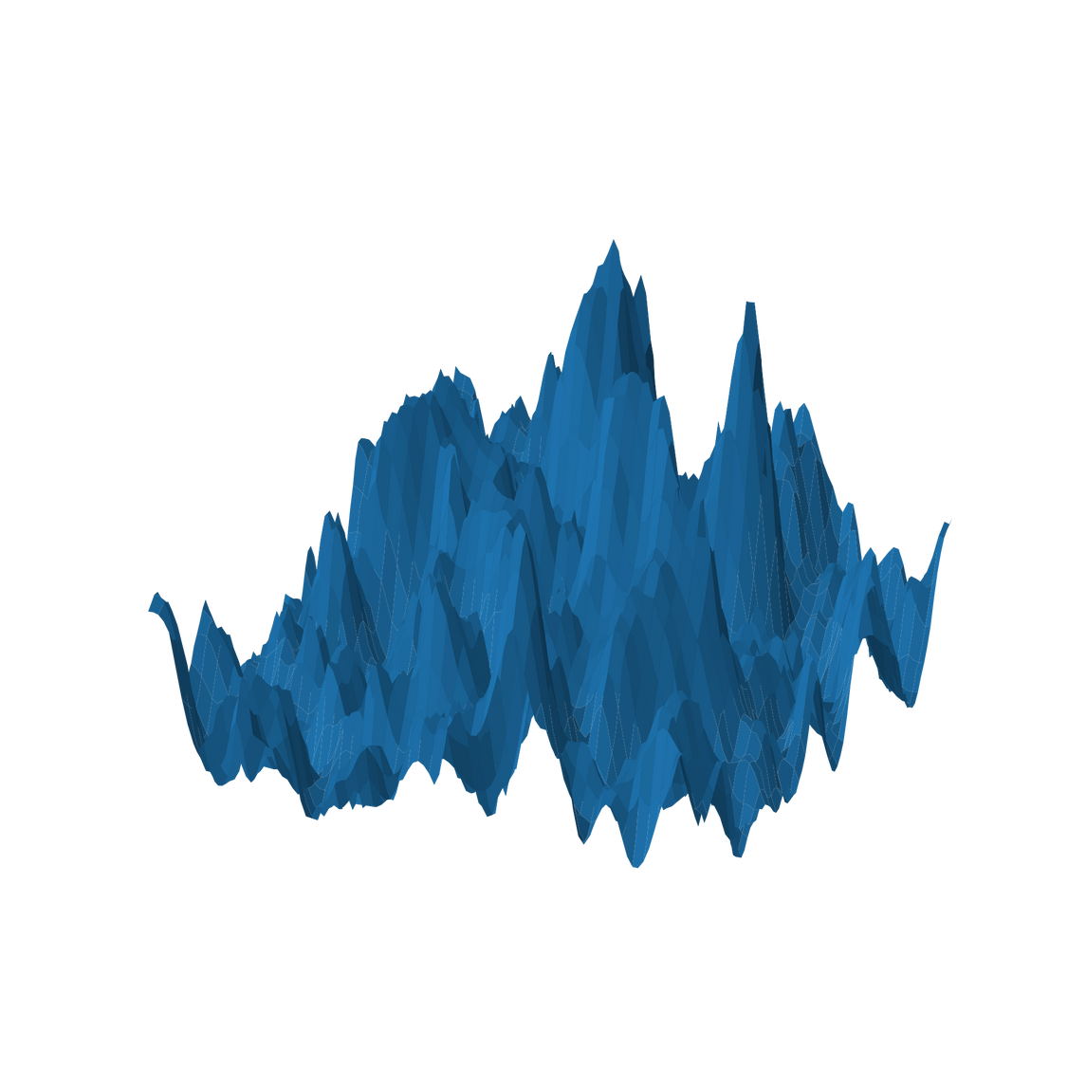
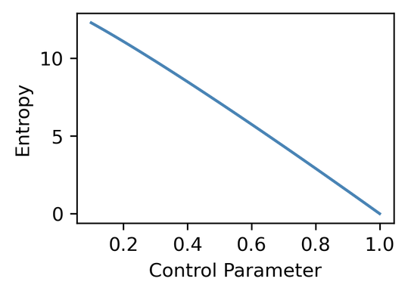
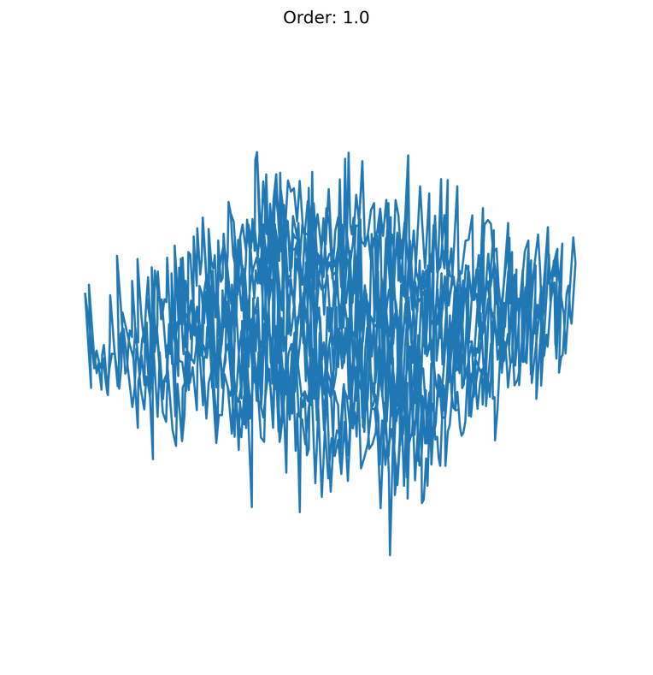
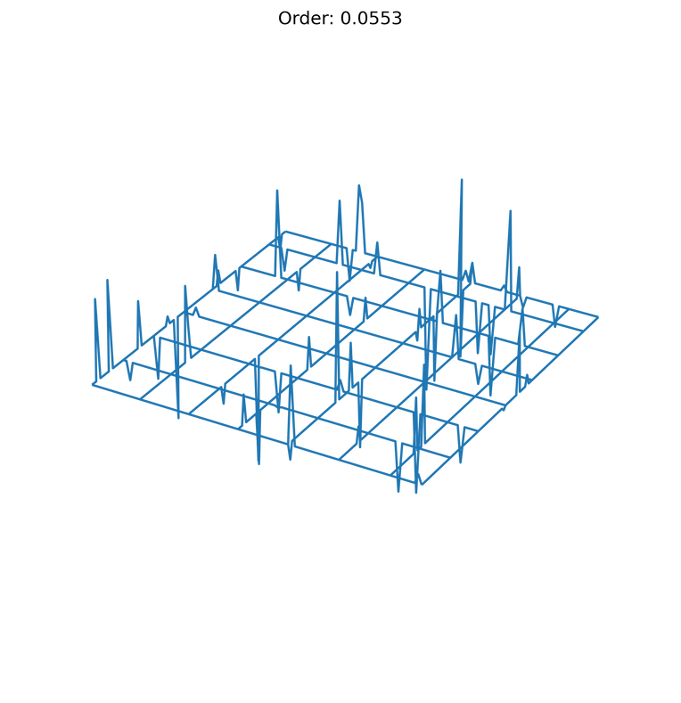
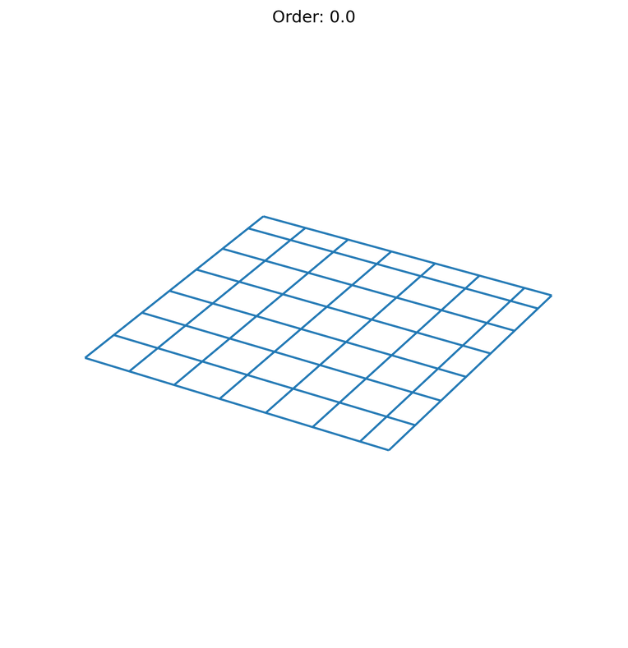
Popović, P., Finkel, J., Silber, M. C., & Abbot, D. S. (2020). Snow topography on undeformed Arctic sea ice captured by an idealized “snow dune” model. Journal of Geophysical Research: Oceans, 125, e2019JC016034. https:// doi.org/10.1029/2019JC016034
Data: Topography
Control Parameter can control order (fractal dimension 2) of the topography
From uniform (order: 1) to normally distributed (order: 0) topography
Model generated topography based on LiDAR measurements
Generated data statistically indistinguishable from real measurements

Slide 11
MODEL LIMITATIONS
1
Fixed parameters for complex subprocesses used as approximations.
Isolated System: Exclusion of interactions with external processes.
Discretisation of time and space.
2
3

Slide 12
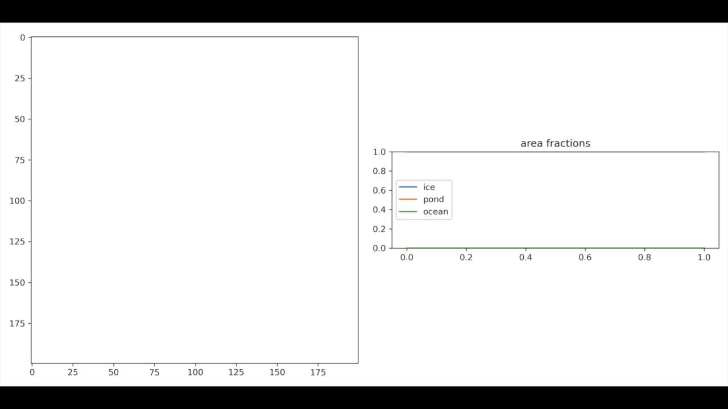

Slide 13

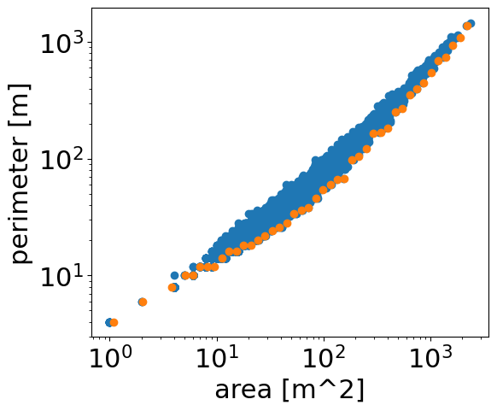
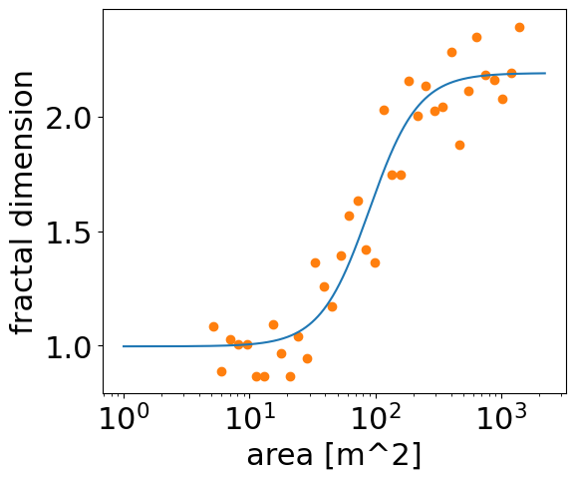
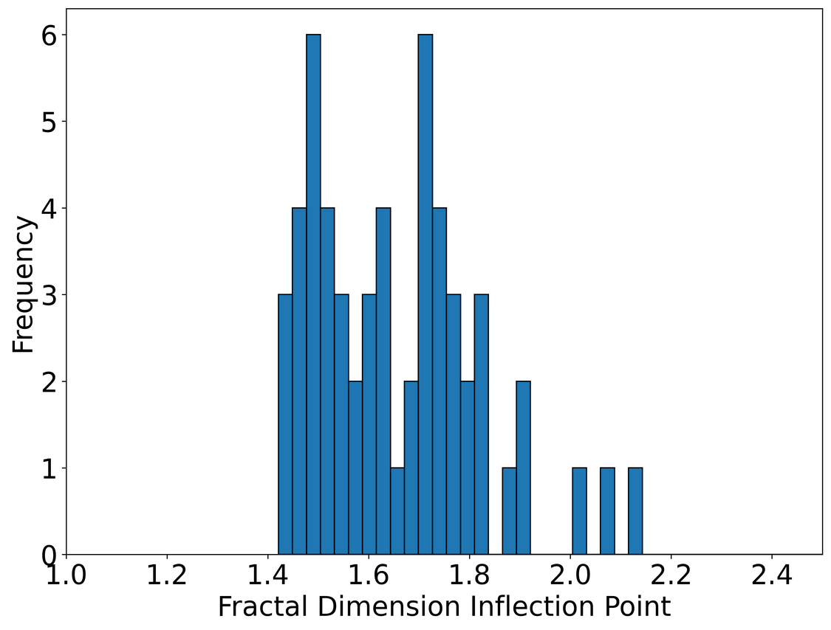
Experimental Setup
Bootstrapping 100x
Building inflection point distribution
Pond distribution
Inflection point
Notes:
- orange points are least complex shape for this area
Model Configuration:
- 4 days of melt
- 500x500 grid

Slide 14

Necessary model ingredients
Model Part removed | p-value | Breaks fractal geometries?
No part removed | 0.803 | base case
Enhanced melt rate | <0.001*
Horizontal flux | <0.001*
Ice melting | <0.001*
Seepage | <0.001*
Periodic Boundaries | <0.001
Order of the topology | n/a | Order parameter greater 1
significant = *

Slide 15
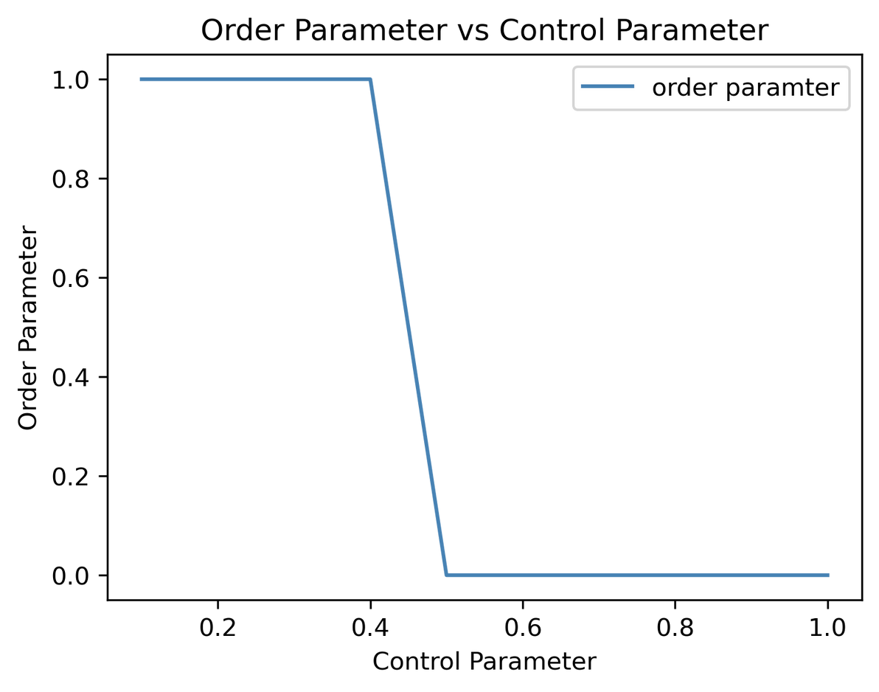
Topography
Order Data:
Order parameter = p-value based presence of fractal dimension 2
Threshold at control ≈ 0.5
at least 50% of the topography needs to be random for complex shapes
Real Data:
Observe same fractal dimension transition emerge

Slide 16
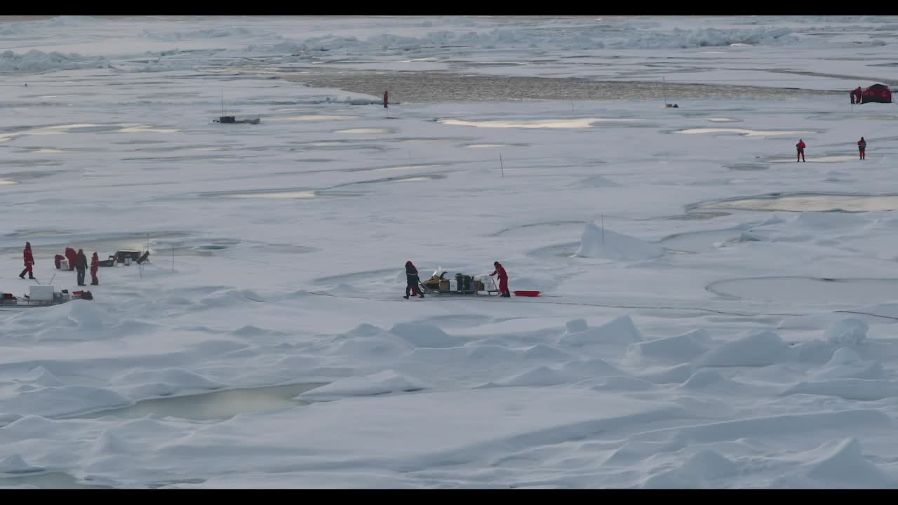

Thank you!
https://the-melt-ponders.streamlit.app/
Feel free to approach us if you have any questions.
Presented by: Group 7

Slide 17
Appendix
Exploring fractal dimensions of Arctic Melt Ponds
Presented by: Group 7

Slide 18
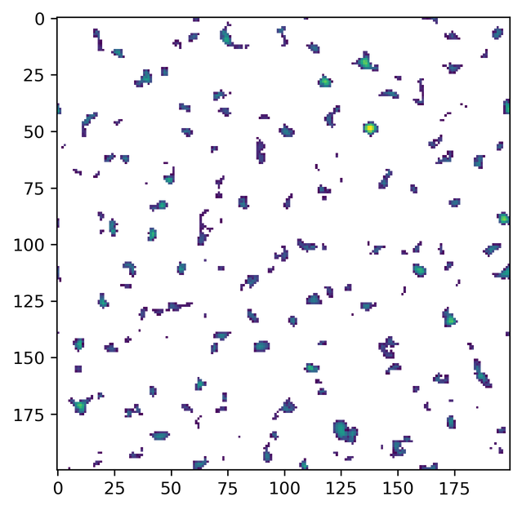
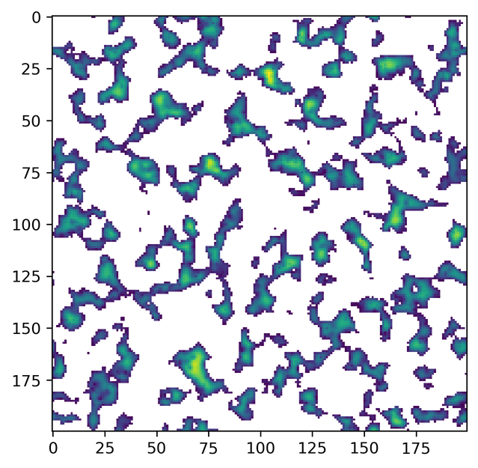
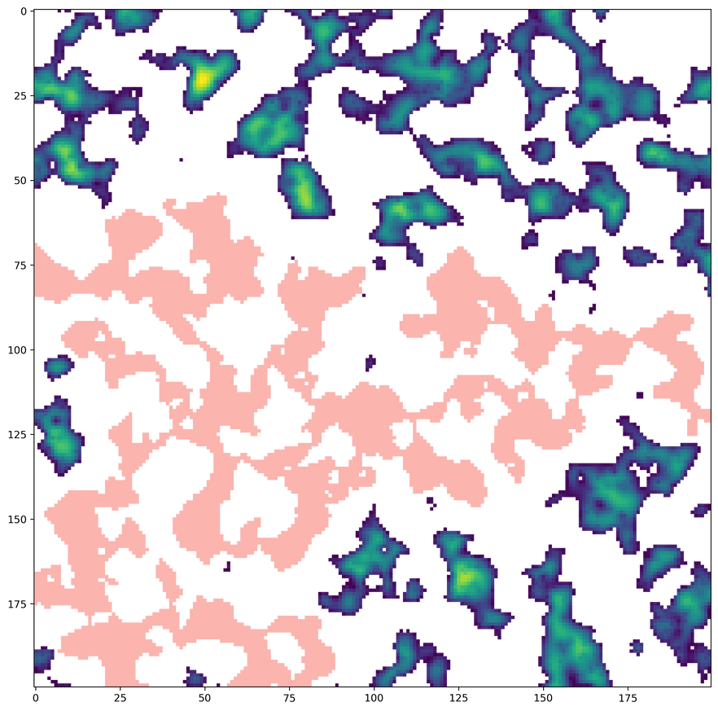
Percolation threshold
40h: D=1
60h: D=2
100h: percolation
Fractal dimension 2 as a necessary condition for percolation (pink). We found no scenario were simple euclidean-shaped ponds emerged in and formed a percolating cluster before transitioning to non-percolating complex pond structures first.

Slide 19
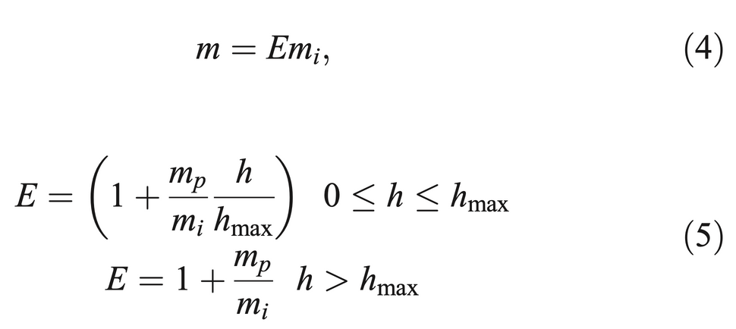
Late Percolation
m is effective melt rate
h is the water height
E the enhancement factor due to pond depth
m_p is the maximal pond melt rate
m_i is the ice melt rate
h_max is the water level where melting is not further enhanced if ponds are deeper
Reason why percolation happens much later than transition to D=2
Enhanced melt rate leads ponds to become deeper after reaching D=2.
Deep ponds lead to large gradient to neighbouring cells: Water close to pond flows into pond rather then enhancing melting around it.

